Slide 1

ACADEMICS

Slide 2

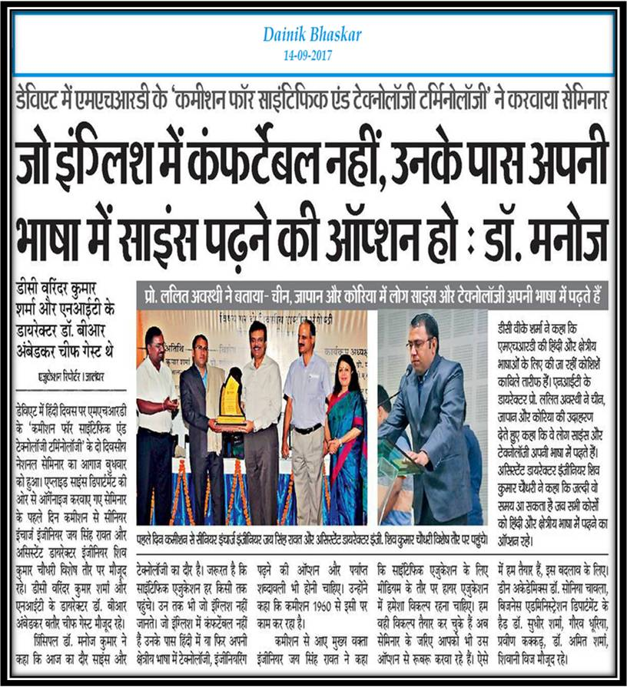

Slide 3
